Slide 1

ABC-University Project
Labi Michael

Slide 2
Quiz App
Login, Register, Authentication
Admin create, read, update, delete users, questions & results.
Student can read questions and submit results.

Slide 3
Project Goals
Prove the application of concepts learnt and practice by applying to a project as an individual.
Apply various libraries, frameworks and tools.
Integrate the code from back-end to front end.

Slide 4
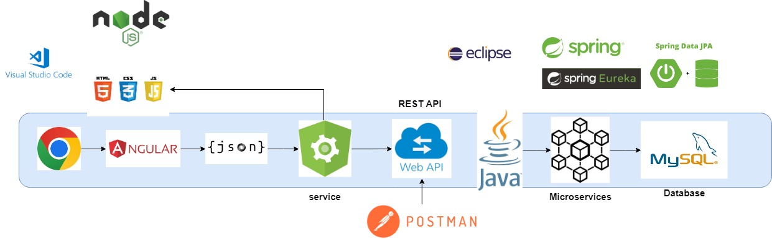
Project Architecture Overview

Slide 5
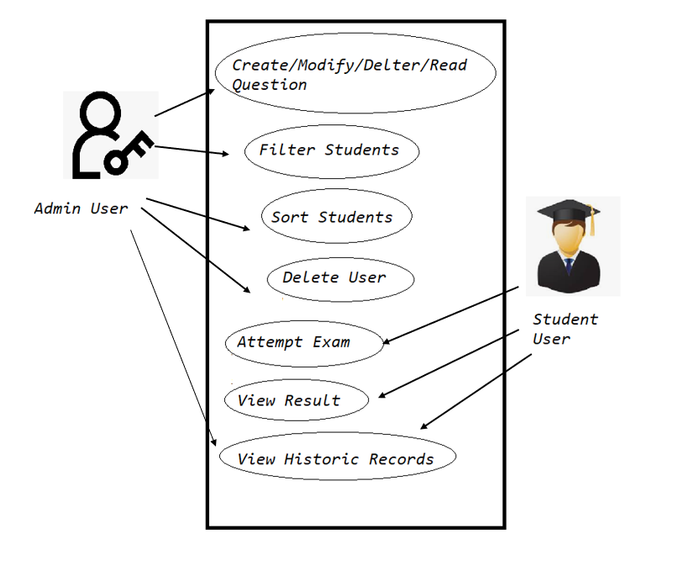
Use Case

Slide 6
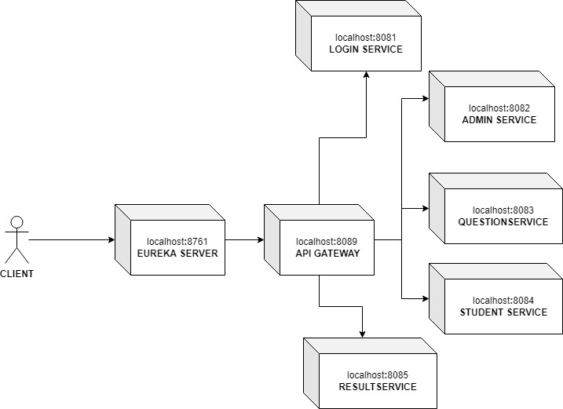
Microservices

Slide 7
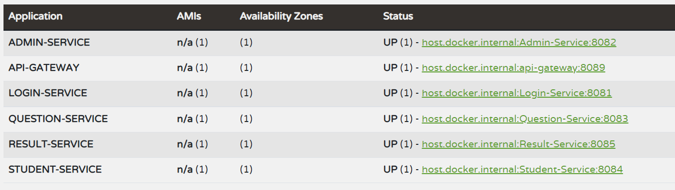
Spring Eureka

Slide 8
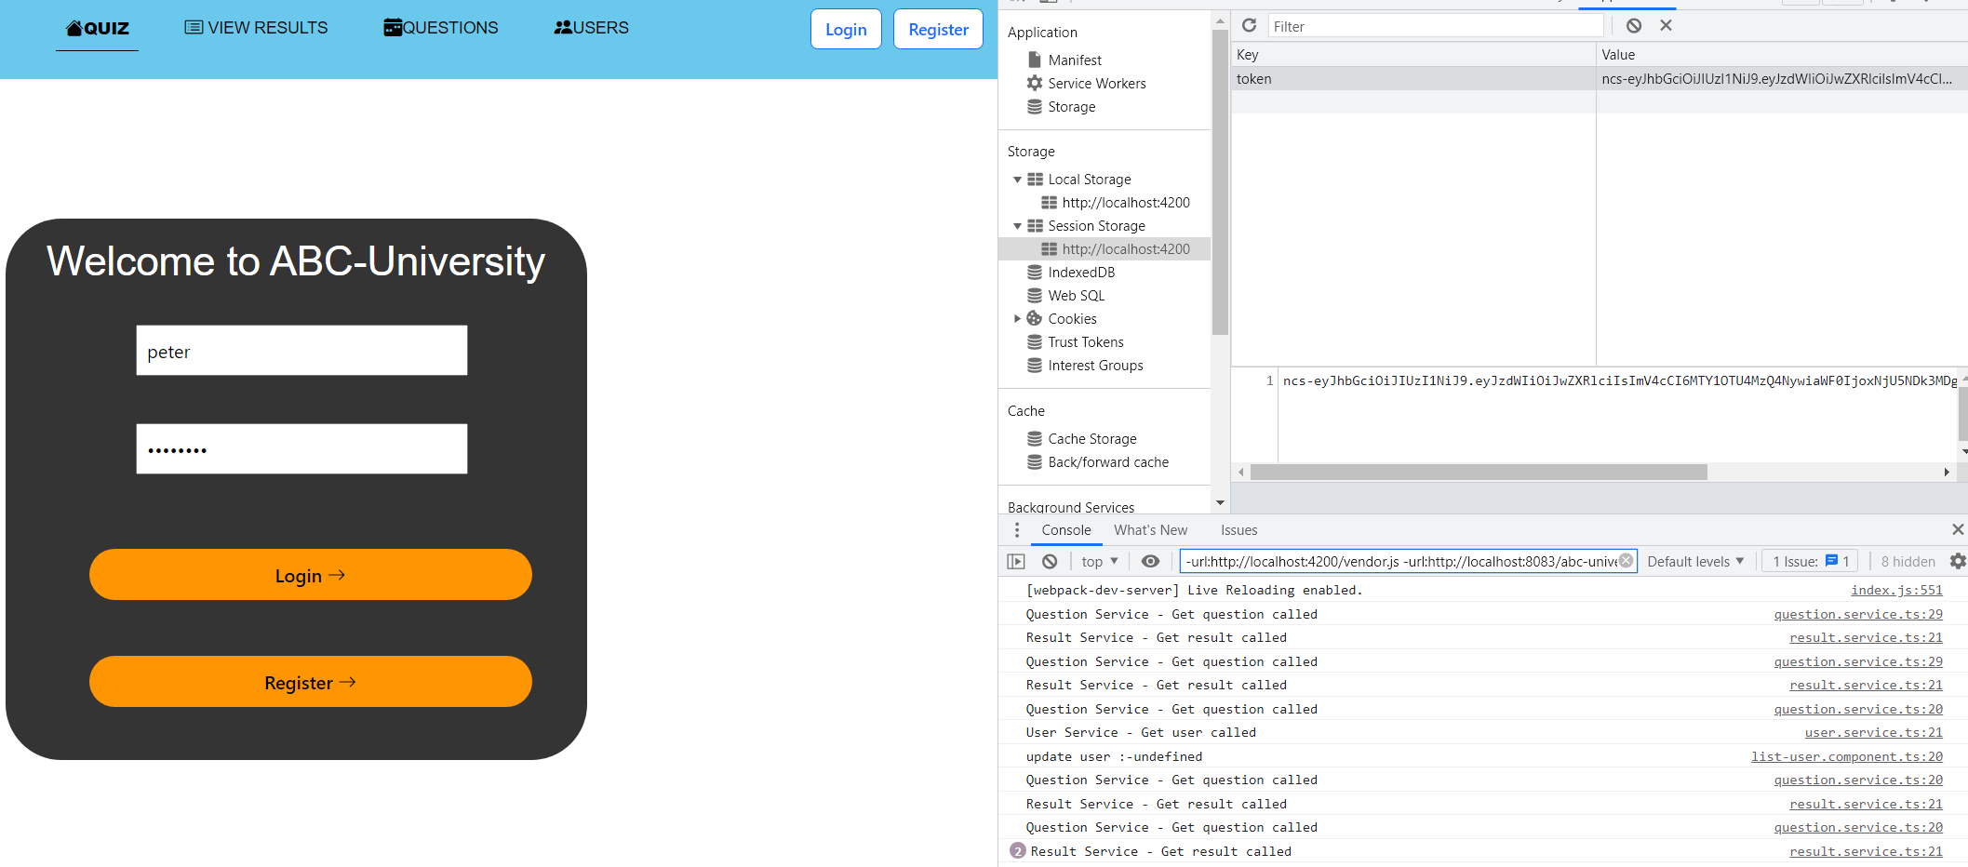
Quiz App – Login (JWTtoken)

Slide 9
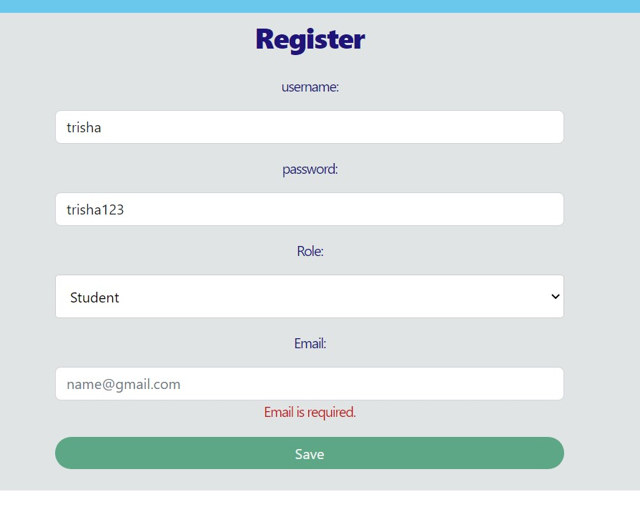
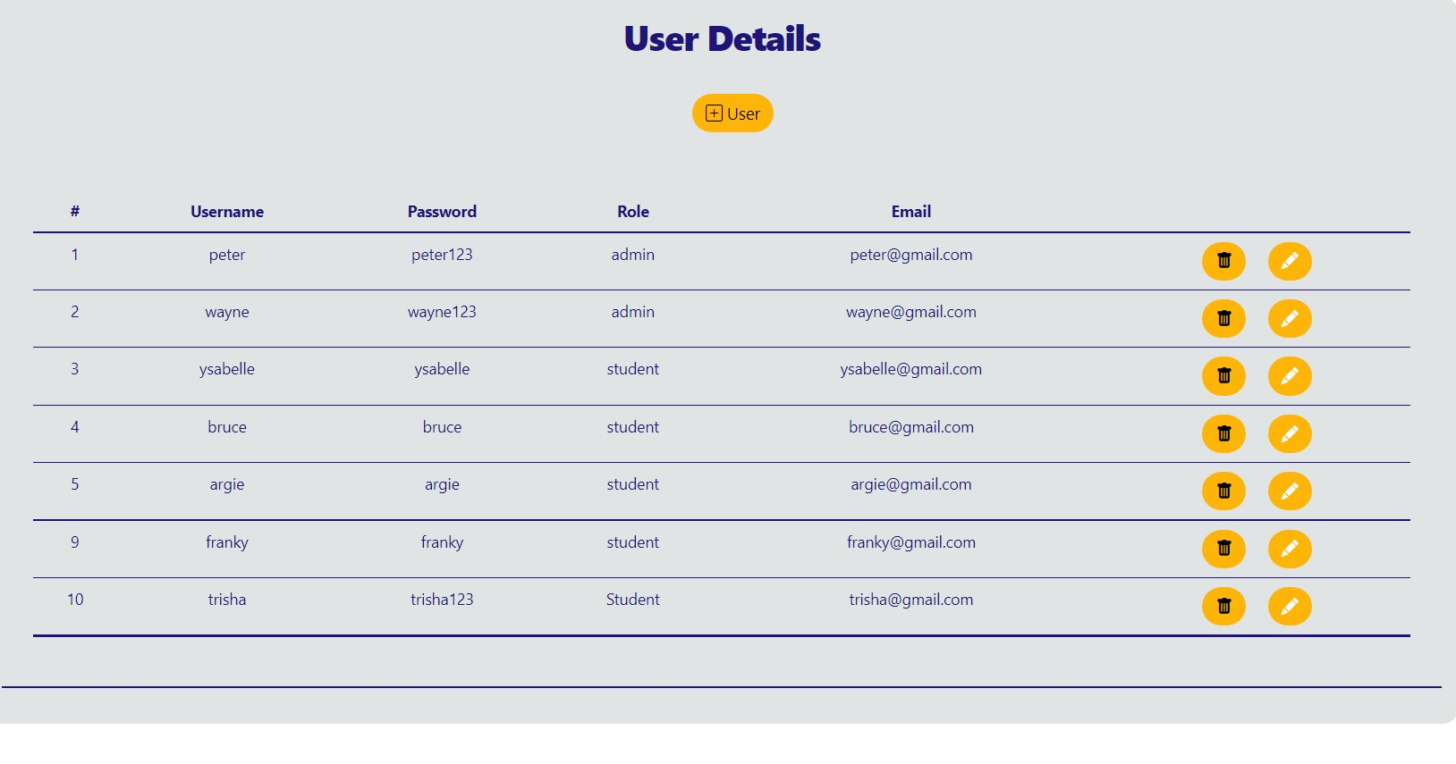
Quiz App

Slide 10
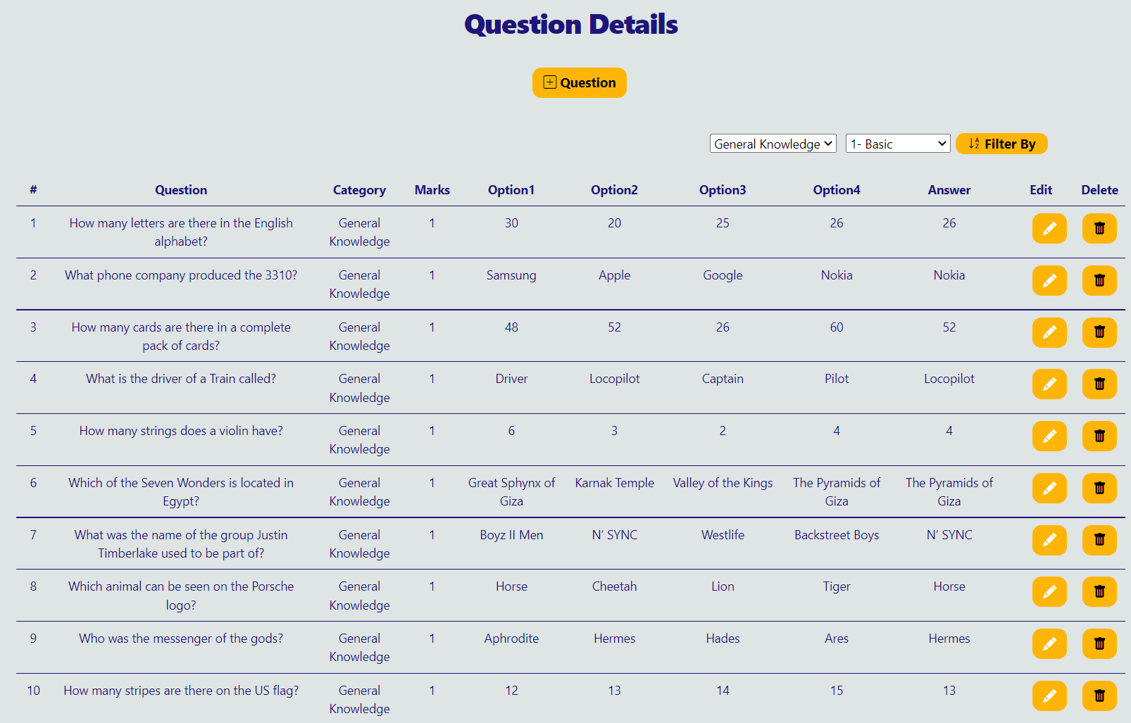
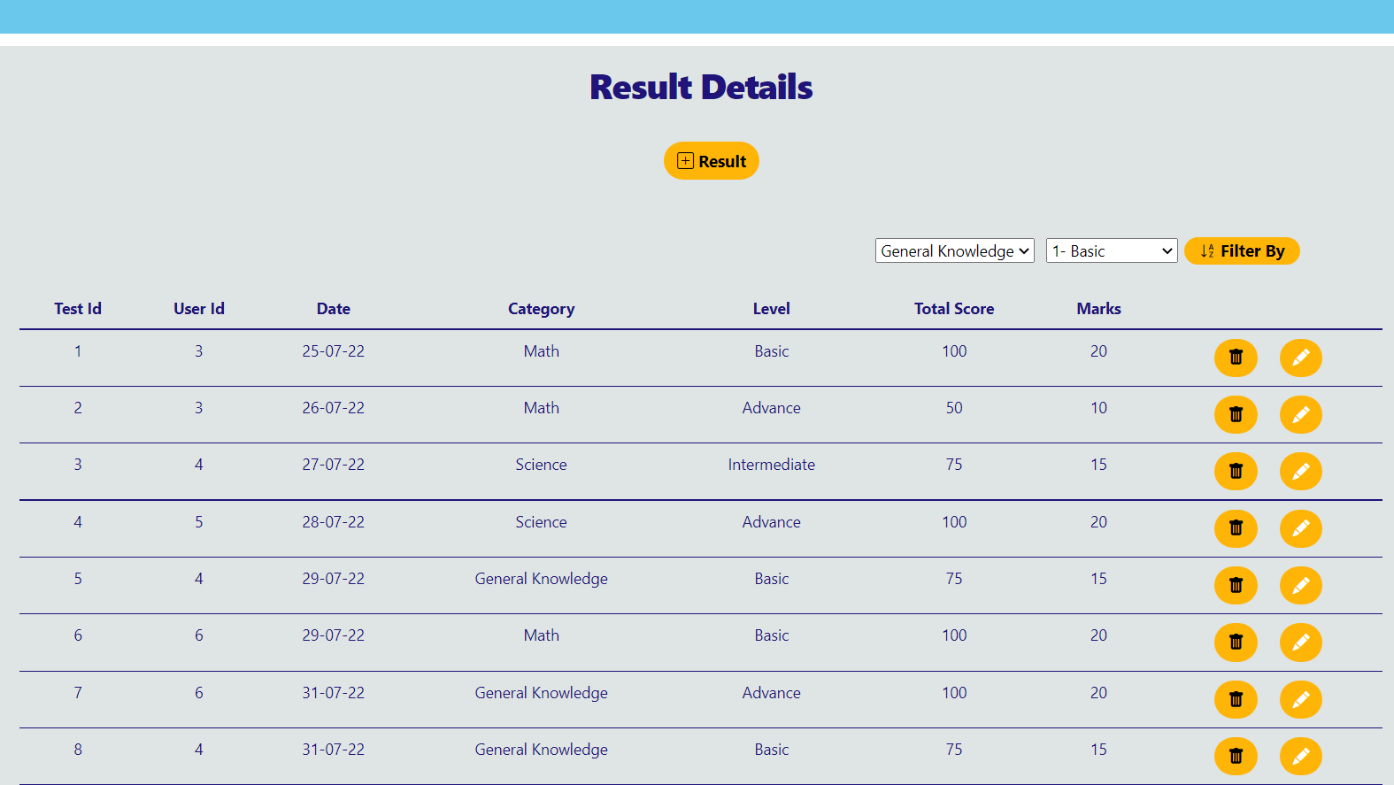
Quiz App

Slide 11
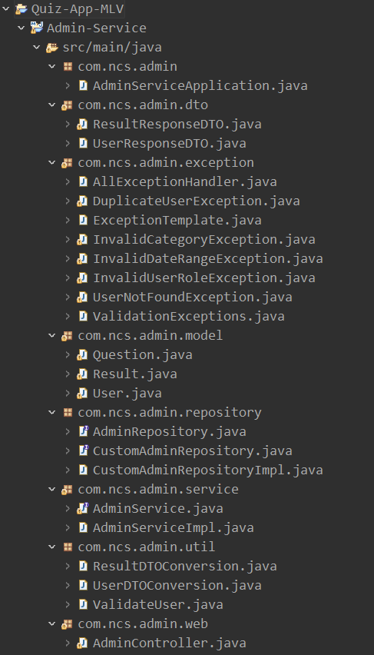
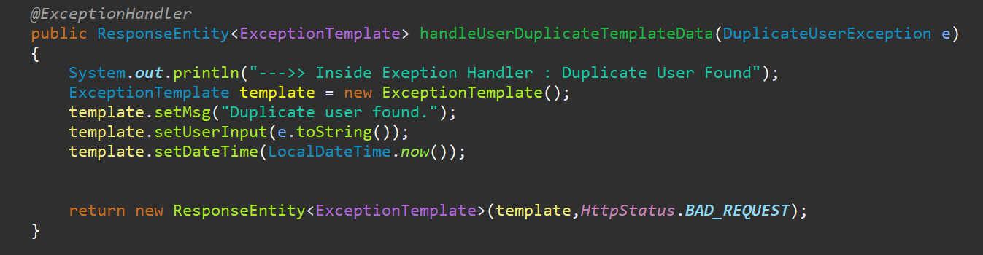
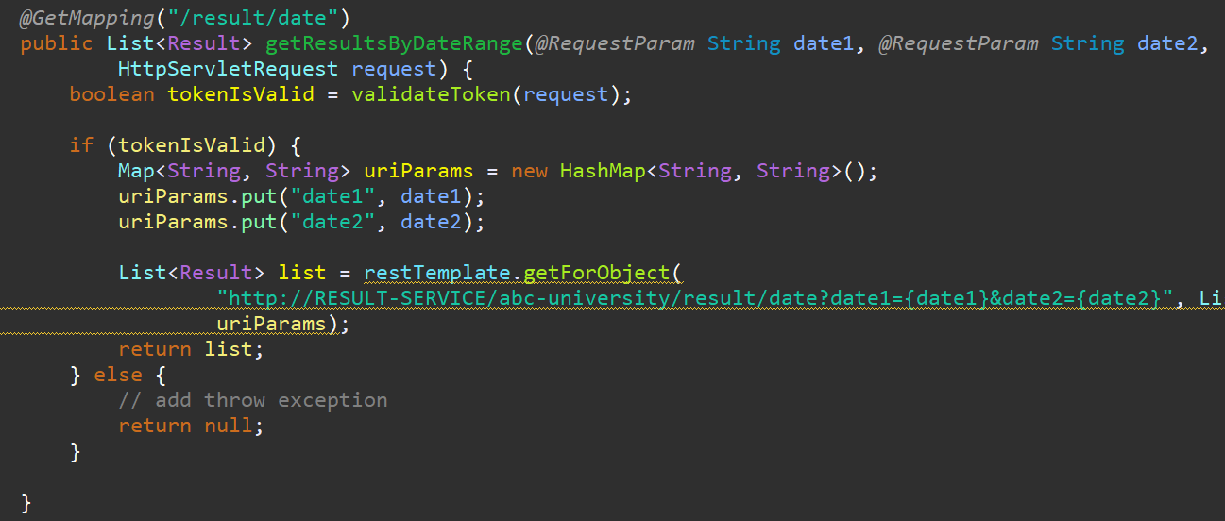
Java

Slide 12
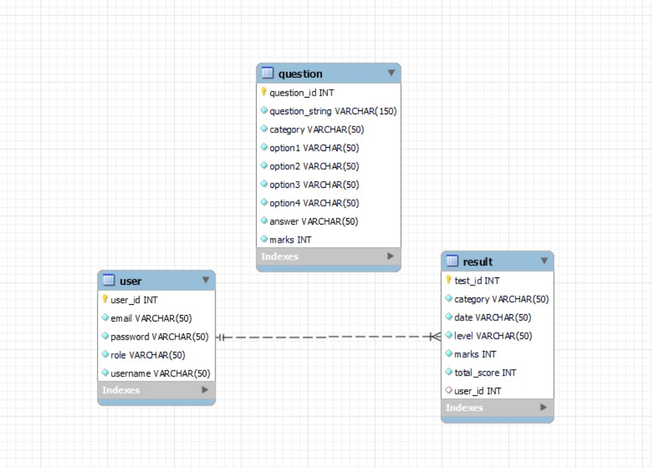
Database

Slide 13
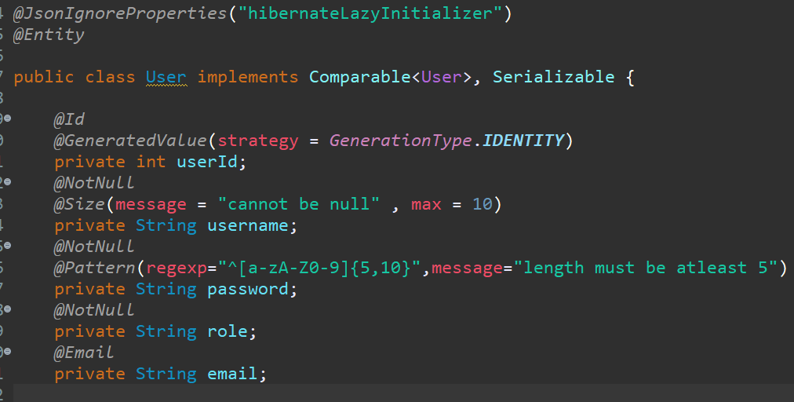
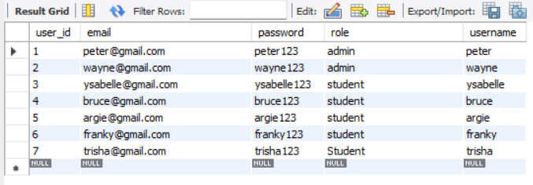
QuizDB - User

Slide 14
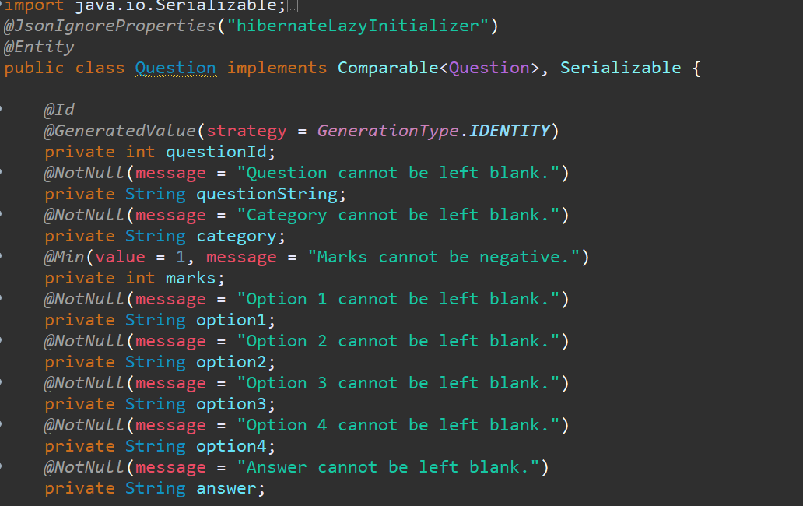
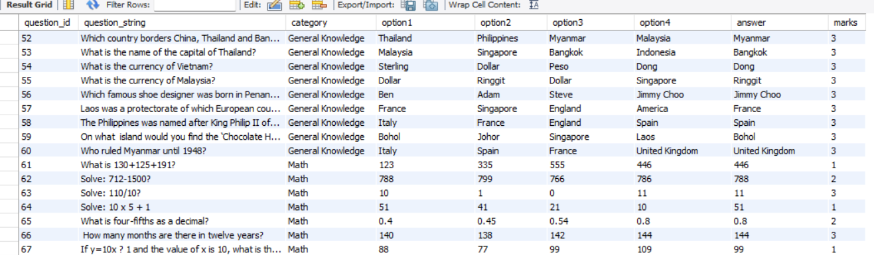
QuizDB – Question

Slide 15
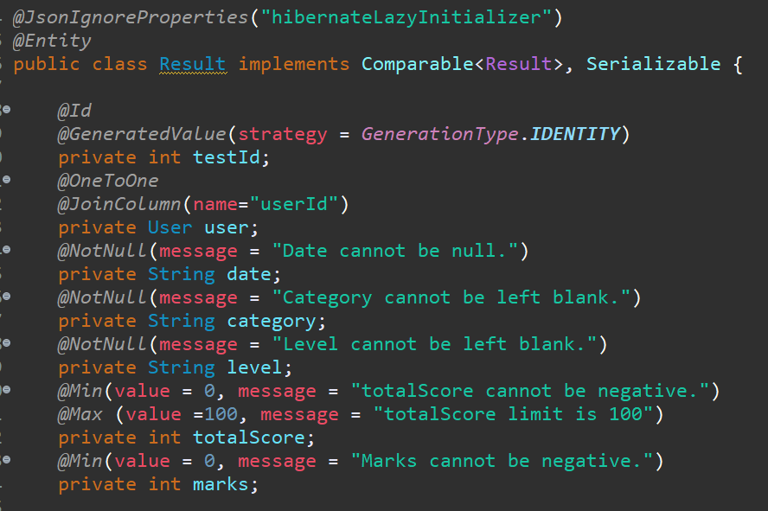
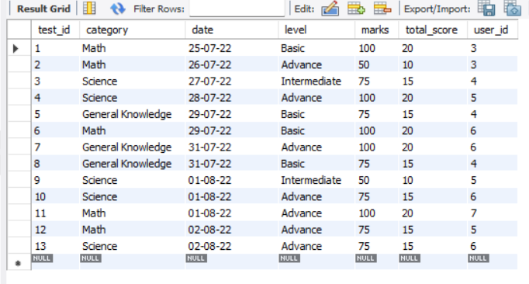
QuizDB - Result

Slide 16
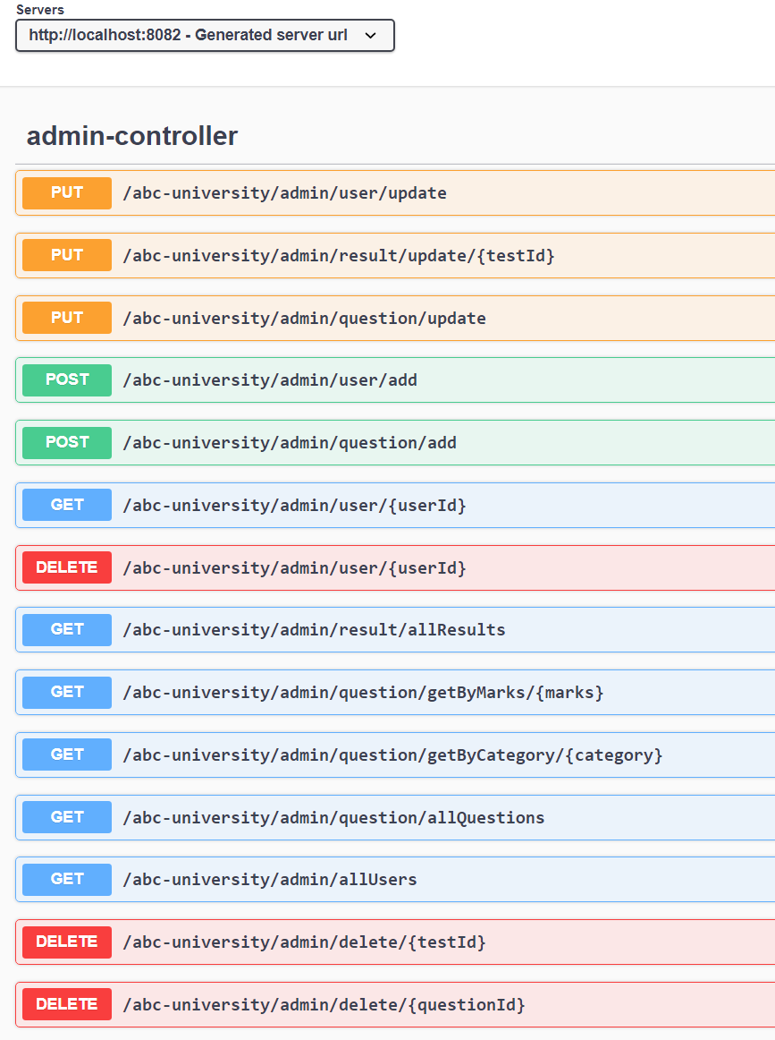
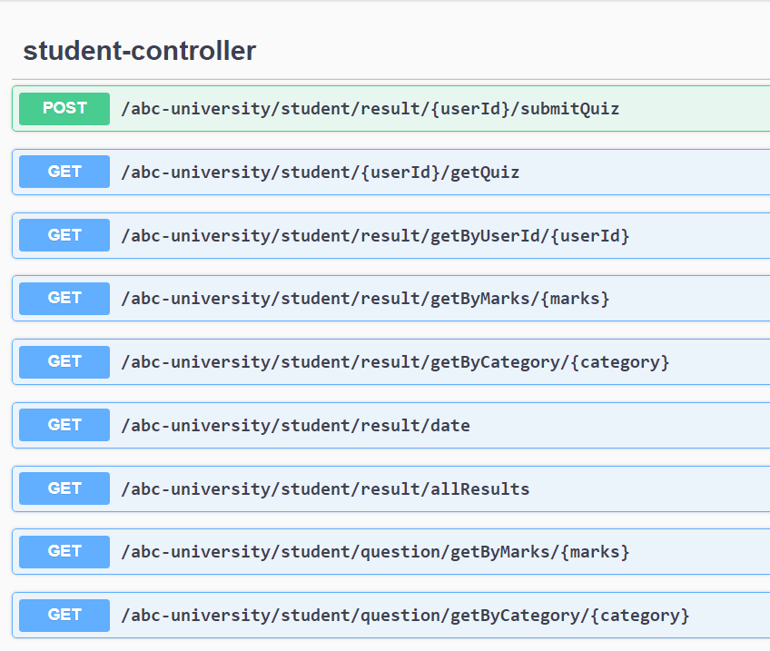
Swagger

Slide 17
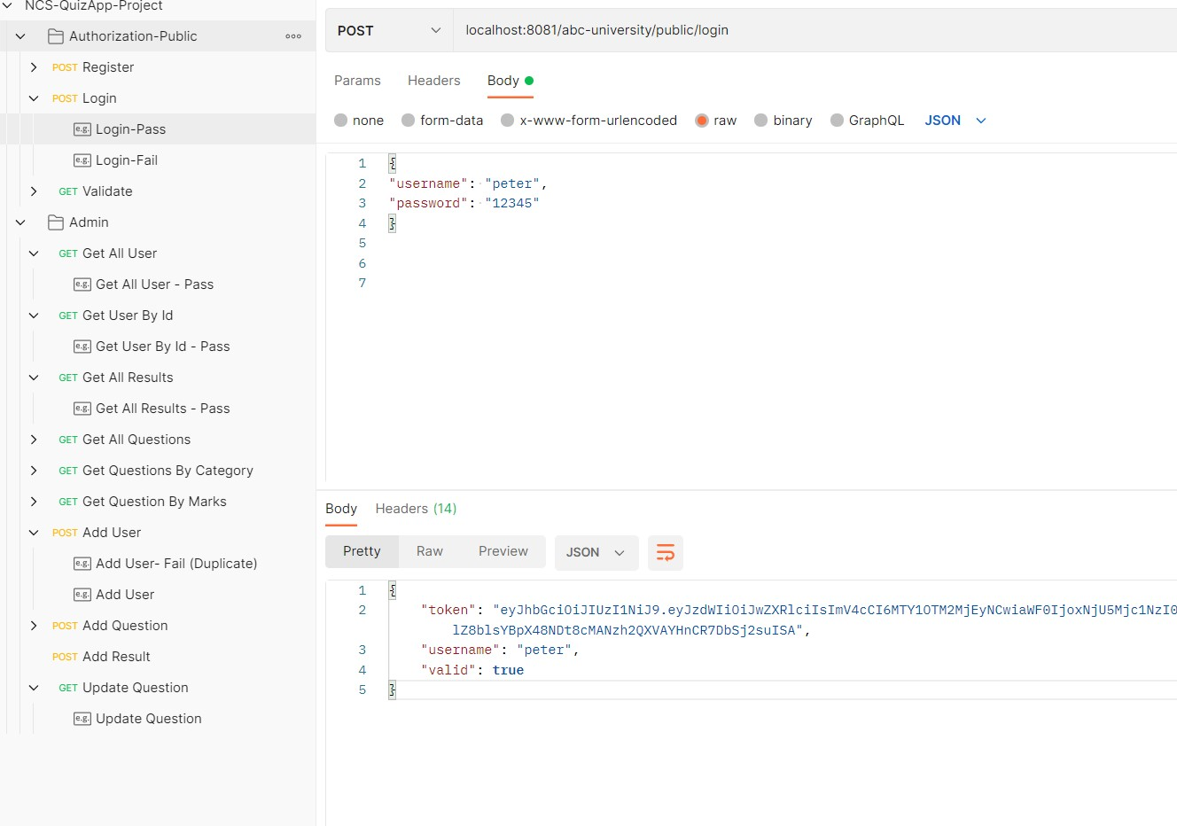
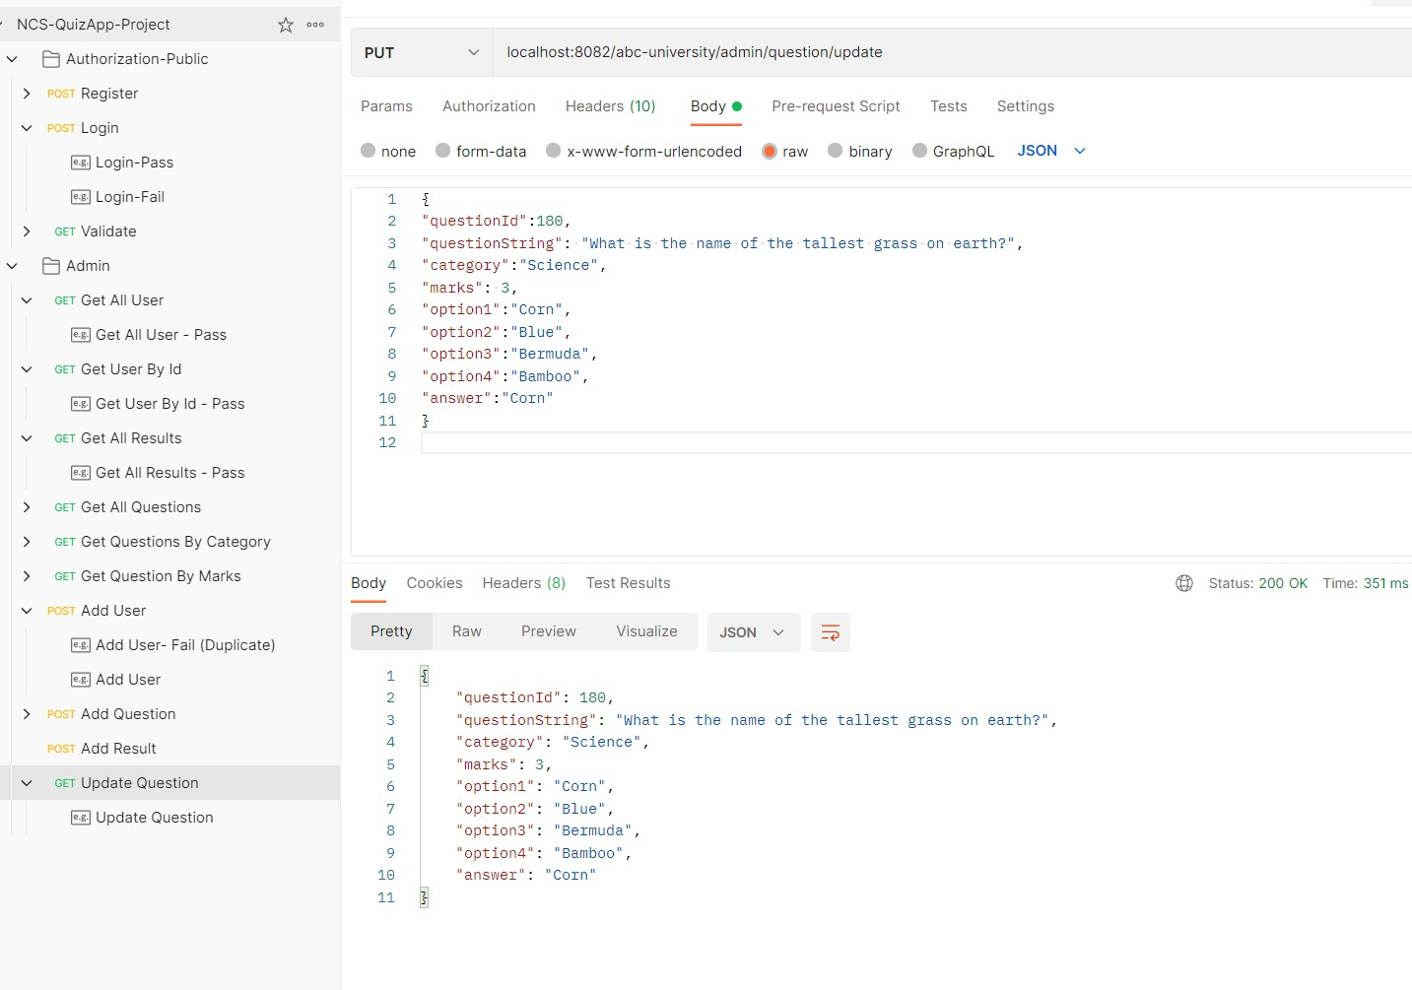
POSTMAN

Slide 18
Future Work
Add more exceptions (duplicate question/answer)
Create Junit TestCase
Improve Angular front end
Further improve code

